Slide 1


Chapter 5 Data Link Layer
Computer Networking: A Top Down Approach 6th edition Jim Kurose, Keith Ross Addison-Wesley March 2012

Slide 2
Link layer, LANs: outline
5.1 introduction, services
5.2 error detection, correction
5.3 multiple access protocols
5.4 LANs
addressing, ARP
Ethernet
switches
VLANS
5.5 link virtualization: MPLS
5.6 data center networking
5.7 a day in the life of a web request

Slide 3
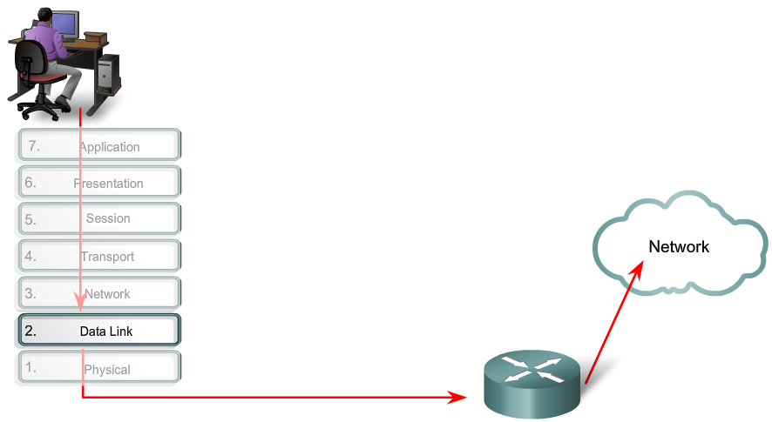
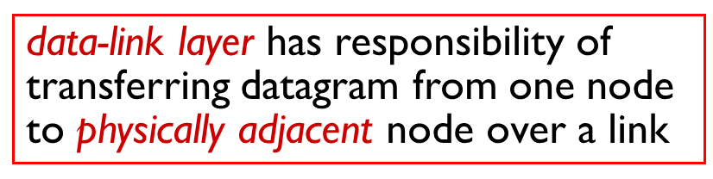
Purpose of the Data Link Layer Data Link Layer
Notes:
9.1.1.1 The Data Link Layer

Slide 4
Link layer services
Framing: Link-layer protocols encapsulate each network layer datagram within a link-layer frame before transmission over the link.
A frame consists of a data field, in which the network-layer datagram is inserted, and other header fields.
The frame structure is specified by the link-layer protocol.
Link access. A MAC protocol specifies the rules by which a frame is transmitted onto the link.
For point-to-point links, the MAC protocol is simple – the sender can send a frame whenever the link is idle.
For multiple nodes sharing a single broadcast link (multiple access problem), the MAC protocol coordinates the frame transmissions of the many nodes.

Slide 5
Link layer services
Reliable delivery. When a link-layer protocol provides reliable delivery services, it guarantees to move each network-layer datagram across the link without error.
Similar to a transport-layer reliable delivery service, a link-layer reliable delivery service can be achieved with acknowledgments and retransmissions.
A link-layer reliable delivery service is often used for links prone to high error rates, such as a wireless link to correct an error locally – on the link where the error occurs.
Error detection & correction. The link-layer hardware in a receiving node can incorrectly interchange bits due to signal attenuation and electromagnetic noise.
Link-layer protocols detect such bit errors by having the transmitting node include error-detection bits in the frame, and having the receiving node perform an error check.

Slide 6
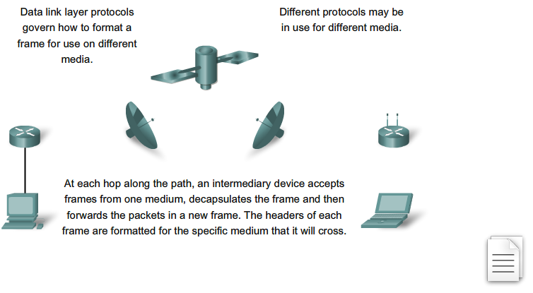
Link layer services
Notes:
9.1.1.3 Media Access Control

Slide 7
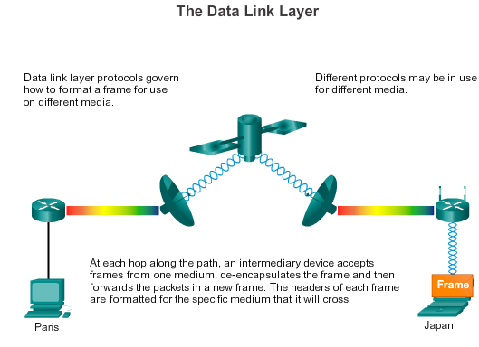
Link layer services
Notes:
10.1.4.2 End-to-End Connectivity, MAC, and IP (cont.)

Slide 8
MAC Sublayer
Data encapsulation
Frame assembly before transmission and frame disassembly upon reception of a frame.
MAC layer adds a header and trailer to the packet
Provides three primary functions:
Frame delimiting – Identifies a group of bits that comprise a frame, synchronization
Addressing –adds a physical address (MAC address) that enables a frame to be delivered to a destination node.
Error detection –adds a trailer with a cyclic redundancy check (CRC) of the frame contents.
Notes:
10.1.1.2 MAC Sublayer (cont.)
The Start frame delimiter is a single byte, 10101011, which is a frame flag, indicating the start of a frame.

Slide 9
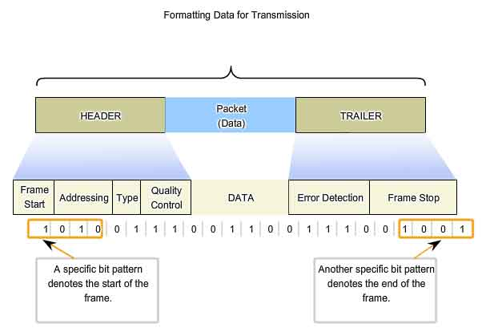
Framing
Notes:
9.1.2.1 Formatting Data for Transmission

Slide 10
Link layer services
flow control:
nodes on each side of a link have a limited amount of packet buffering capacity
pacing between adjacent sending and receiving nodes
error detection:
errors caused by signal attenuation, noise.
receiver detects presence of errors:
signals sender for retransmission or drops frame
error correction:
receiver identifies and corrects bit error(s) without resorting to retransmission
half-duplex and full-duplex
with half duplex, nodes at both ends of link can transmit, but not at same time

Slide 11
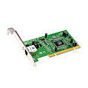
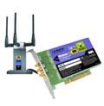
Where is the link layer implemented?
in each and every host
link layer implemented in “adaptor” (aka network interface card NIC)
Ethernet card, PCMCI card, 802.11 card
implements link, physical layer
attaches into host’s system buses
combination of hardware, software, firmware
host schematic
application
transport
network
link
cpu
memory
link
physical
host
bus
(e.g., PCI)
controller
physical
transmission
network adapter
card

Slide 12
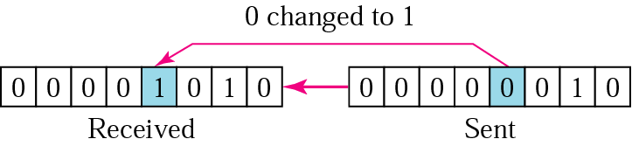
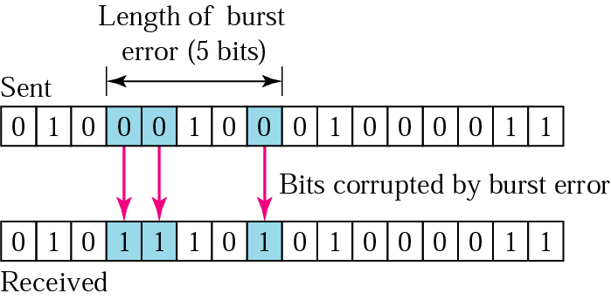
Types of Errors
An error occurs when a bit is altered between transmission and reception
Binary 1 is transmitted and binary 0 is received
Binary 0 is transmitted and binary 1 is received
Single bit Error
Burst Error – 2 or more bits changed

Slide 13
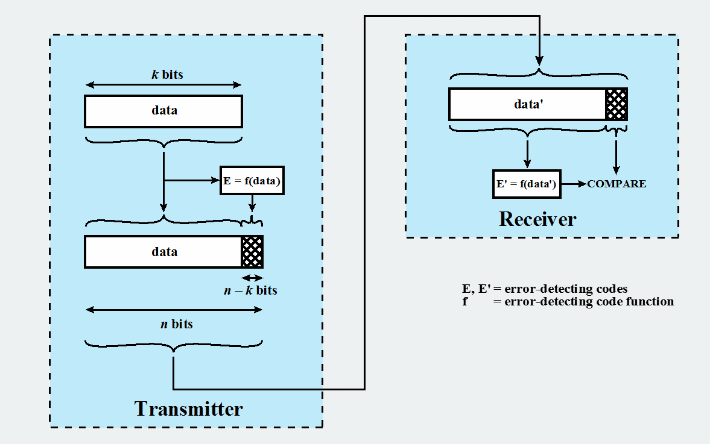
Error Detection Process

Slide 14
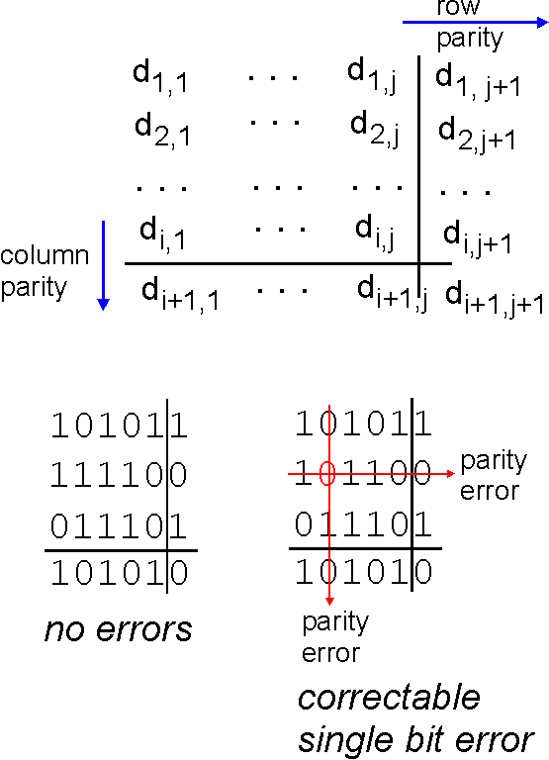
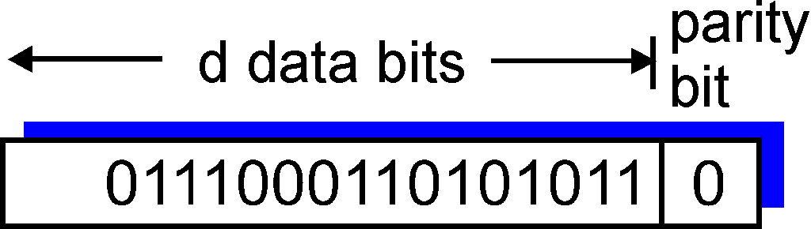
Example: Parity checking
two-dimensional bit parity:
detect and correct single bit errors
A parity bit is added to every data unit so that the total number of 1s is even (or odd for odd-parity).
A simple parity-check code can detect an odd number of errors.
single bit parity:
detect single bit errors
Two-dimensional bit parity
Detect up to 3 bit errors
TO Read, Internet Checksum and CRC
Notes:
A simple parity-check code can detect an odd number of errors.
Two-dimensional bit parity can only check upto 3 bit errors

Slide 15





Multiple access links, protocols
two types of “links”:
point-to-point
PPP for dial-up access
point-to-point link between Ethernet switch, host
broadcast (shared wire or medium)
Older Ethernet
upstream Hybrid fiber-coaxial (HFC)
802.11 wireless LAN
shared wire (e.g.,
cabled Ethernet)
shared RF
(e.g., 802.11 WiFi)
shared RF
(satellite)
humans at a
cocktail party
(shared air, acoustical)

Slide 16
Multiple Access problem
Issues with broadcast (shared wire or medium)
two or more simultaneous transmissions by nodes: interference
collision if node receives two or more signals at the same time
multiple access protocol
distributed algorithm that determines how nodes share channel, i.e., determine when node can transmit
Notes:
Typically, when there is a collision, none of the receiving nodes can make any sense of any of the
frames that were transmitted; in a sense, the signals of the colliding frame become inextricably tangled together. Thus, all the frames involved in the collision are lost, and the broadcast channel is wasted during the collision interval. Clearly, if many nodes want to frequently transmit frames, many transmissions will result in collisions, and much of the bandwidth of the broadcast channel will be wasted.

Slide 17
MAC Protocols
Round robin
Each station given turn to transmit data
Reservation/ channel partitioning
Divide medium into slots
Good for stream traffic
Contention
All stations contend for time
Good for bursty traffic
Simple to implement
Tends to collapse under heavy load
Notes:
With round robin, each station in turn is given the opportunity to transmit. During that opportunity, the station may decline to transmit or may transmit subject to a specified upper bound, usually expressed as a maximum amount of data transmitted or time for this opportunity. In any case, the station, when it is finished, relinquishes its turn, and the right to transmit passes to the next station in logical sequence. Control of sequence may be centralized or distributed. Polling is an example of a centralized technique.
When many stations have data to transmit over an extended period of time, round-robin techniques can be very efficient. If only a few stations have data to transmit over an extended period of time, then there is a considerable overhead in passing the turn from station to station, because most of the stations will not transmit but simply pass their turns. Under such circumstances other techniques may be preferable, largely depending on whether the data traffic has a stream or bursty characteristic. Stream traffic is characterized by lengthy and fairly continuous transmissions; examples are voice communication, telemetry, and bulk file transfer. Bursty traffic is characterized by short, sporadic transmissions; interactive terminal-host traffic fits this description.
RESERVATION
For stream traffic, reservation techniques are well suited. In general, for these techniques, time on the medium is divided into slots, much as with synchronous TDM. A station wishing to transmit reserves future slots for an extended or even an indefinite period. Again, reservations may be made in a centralized or distributed fashion.
CONTENTION
For bursty traffic, contention techniques are usually appropriate. With these techniques, no control is exercised to determine whose turn it is; all stations contend for time in a way that can be, as we shall see, rather rough and tumble. These techniques are of necessity distributed in nature. Their principal advantage is that they are simple to implement and, under light to moderate load, efficient. For some of these techniques, however, performance tends to collapse under heavy load.
Although both centralized and distributed reservation techniques have been implemented in some LAN products, round-robin and contention techniques are the most common.

Slide 18
Round Robin (RR)
Each station in turn is given the opportunity to transmit.
During that opportunity, the station may decline to transmit or may transmit subject to a specified upper bound, usually expressed as a maximum amount of data transmitted or time for this opportunity.
When done, the station relinquishes its turn, and the right to transmit passes to the next station in logical sequence.
Control of sequence may be centralized or distributed.
Polling is an example of a centralized technique.
When many stations have data to transmit over an extended period of time, RR techniques are very efficient.
If only a few stations have data to transmit over an extended period of time, there is a huge overhead in passing the turn from station to station, because most of the stations will not transmit but simply pass their turns.

Slide 19
RESERVATION
Stream traffic is characterized by lengthy and fairly continuous transmissions; examples are voice communication, telemetry, and bulk file transfer.
For stream traffic, reservation techniques are well suited.
In general, for these techniques, time on the medium is divided into slots, much as with synchronous TDM.
A station wishing to transmit reserves future slots for an extended or even an indefinite period.
Again, reservations may be made in a centralized or distributed fashion.

Slide 20
CONTENTION
Bursty traffic is characterized by short, sporadic transmissions; interactive terminal-host traffic.
For bursty traffic, contention techniques are usually appropriate. With these techniques, no control is exercised to determine whose turn it is;
All stations contend for time in a way that can be rough and tumble. These techniques are distributed in nature.
Their principal advantage is that they are simple to implement and, under light to moderate load, efficient.
For some of these techniques, however, performance tends to collapse under heavy load.
Although both centralized and distributed reservation techniques have been implemented in some LANs, R-R and contention techniques are more common.

Slide 21
Channel partitioning MAC protocols
TDMA: Time Division Multiple Access
each station gets fixed length slot
unused slots go idle
6-slot
frame
6-slot
frame
1
3
4
1
3
4
FDMA: frequency division multiple access
channel spectrum divided into frequency bands
each station assigned fixed frequency band
time
frequency bands

Slide 22
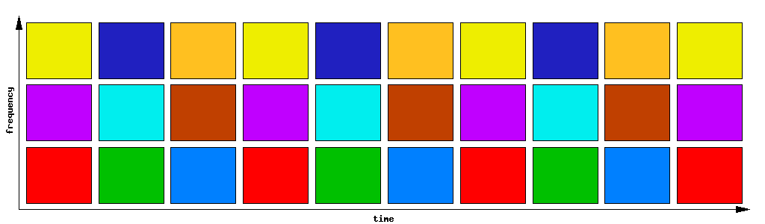
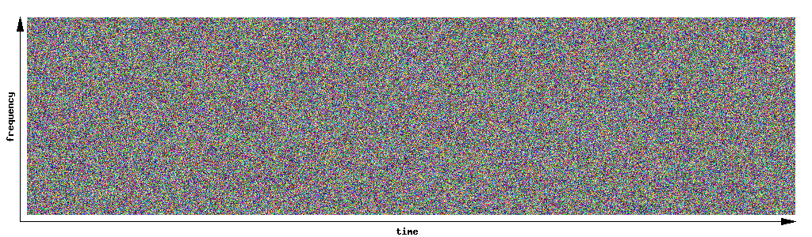
Channel partitioning MAC protocols
F/TDMA
2G Cellular Networks
CDMA: Code division multiple access
Transmissions are combined on the same channel at the same time but are separated by codes
3G Cellular Networks

Slide 23
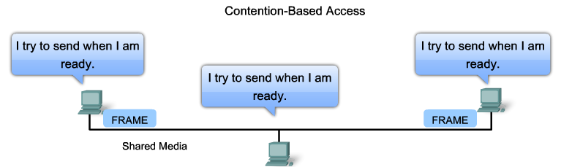
Random Access Protocols
Characteristics | Contention-Based Technologies
Stations can transmit at any time Collision exist How to detect collisions how to recover from collisions (e.g., via delayed retransmissions) There are mechanisms to resolve contention for the media | CSMA/CD for 802.3 Ethernet networks CSMA/CA for 802.11 wireless networks ALOHA
Notes:
9.2.3.3 Contention-Based Access

Slide 24
CSMA/CD
If a collision is detected, transmit a brief jamming signal to assure that all stations know that there has been a collision and cease transmission
3.
After transmitting the jamming signal, wait a random amount of time, referred to as the backoff, then attempt to transmit again
If the medium is idle, transmit; otherwise, go to step 2
If the medium is busy, continue to listen until the channel is idle, then transmit immediately
4.
2.
1.
Notes:
CSMA, although more efficient than ALOHA or slotted ALOHA, still has one glaring inefficiency. When two frames collide, the medium remains unusable for the duration of transmission of both damaged frames. For long frames, compared to propagation time, the amount of wasted capacity can be considerable. This waste can be reduced if a station continues to listen to the medium while transmitting. This leads to the following rules for CSMA/CD:
If the medium is idle, transmit; otherwise, go to step 2.
If the medium is busy, continue to listen until the channel is idle, then transmit immediately.
If a collision is detected during transmission, transmit a brief jamming signal to assure that all stations know that there has been a
collision and then cease transmission.
After transmitting the jamming signal, wait a random amount of time, referred to as the backoff, then attempt to transmit again (repeat
from step 1).

Slide 25
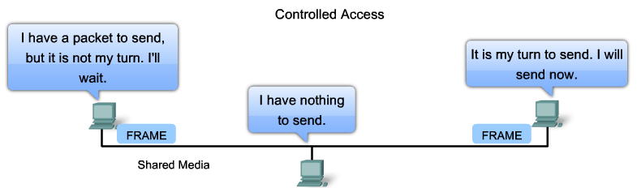
“Taking turns” MAC protocols
Characteristics | Controlled Access Technologies
Only one station can transmit at a time Devices wanting to transmit must wait their turn No collisions May use a token passing method | Token Ring (IEEE 802.5) Fiber Distributed Data Interface (FDDI)
Notes:
9.2.3.5 Controlled Access

Slide 26
“Taking turns” MAC protocols
channel partitioning MAC protocols:
share channel efficiently and fairly at high load
inefficient at low load: delay in channel access, 1/N bandwidth allocated even if only 1 active node!
random access MAC protocols
efficient at low load: single node can fully utilize channel
high load: collision overhead
“taking turns” protocols
look for best of both worlds!

Slide 27

“Taking turns” MAC protocols
polling:
master node “invites” slave nodes to transmit in turn
typically used with “dumb” slave devices
concerns:
polling overhead
latency
single point of failure (master)
data
poll
master
data
slaves

Slide 28
“Taking turns” MAC protocols
token passing:
control token passed from one node to next sequentially.
token message
concerns:
token overhead
latency
single point of failure (token)
T
(nothing
to send)
T
data

Slide 29
Link layer, LANs: outline
5.1 introduction, services
5.2 error detection, correction
5.3 multiple access protocols
5.4 LANs
addressing, ARP
Ethernet
switches
VLANS
5.5 link virtualization: MPLS
5.6 data center networking
5.7 a day in the life of a web request

Slide 30
MAC addresses and ARP
MAC (or LAN or physical or Ethernet) address:
function: used ‘locally” to get frame from one interface to another physically-connected interface (same network, in IP-addressing sense)
48 bit MAC address (for most LANs) burned in NIC ROM, also sometimes software settable
e.g.: 1A-2F-BB-76-09-AD
hexadecimal (base 16) notation
(each “number” represents 4 bits)

Slide 31
LAN addresses and ARP
each adapter on LAN has unique LAN address
1A-2F-BB-76-09-AD
LAN
(wired or
wireless)
adapter
71-65-F7-2B-08-53
58-23-D7-FA-20-B0
0C-C4-11-6F-E3-98

Slide 32


ARP: Address Resolution Protocol
Question: how to determine
interface’s MAC address, knowing its IP address?
ARP table: each IP node (host, router) on LAN has table
IP/MAC address mappings for some LAN nodes:
< IP address; MAC address; TTL>
TTL: time after which address mapping will be forgotten (typically 20 min)
137.196.7.78
1A-2F-BB-76-09-AD
137.196.7.23
137.196.7.14
LAN
71-65-F7-2B-08-53
58-23-D7-FA-20-B0
0C-C4-11-6F-E3-98
137.196.7.88

Slide 33
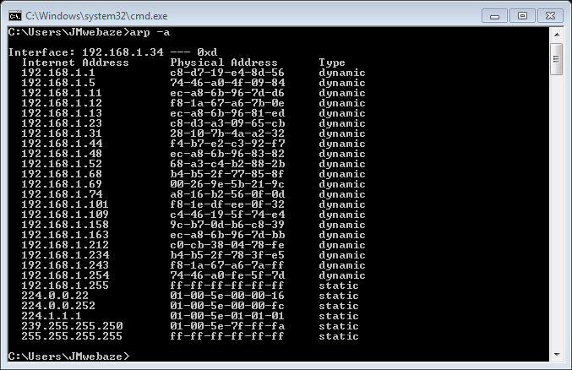
arp table – arp -a

Slide 34
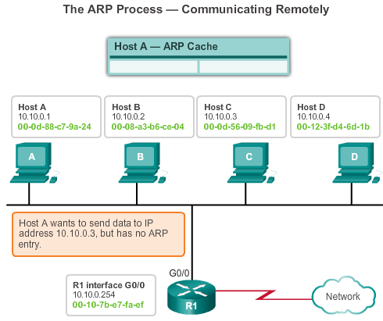
ARP Operation
Notes:
10.2.1.3 ARP Operation

Slide 35
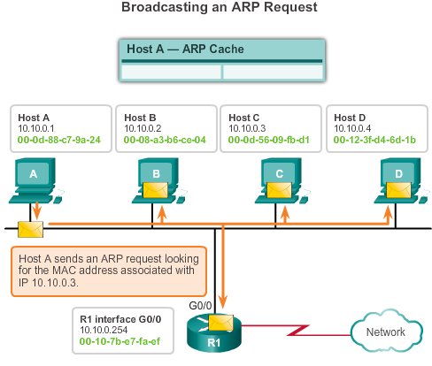
ARP Operation (cont.)
Notes:
10.2.1.3 ARP Operation (cont.)

Slide 36
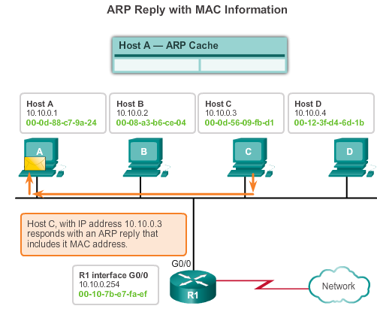
ARP Operation (cont.)
Notes:
10.2.1.3 ARP Operation (cont.)

Slide 37
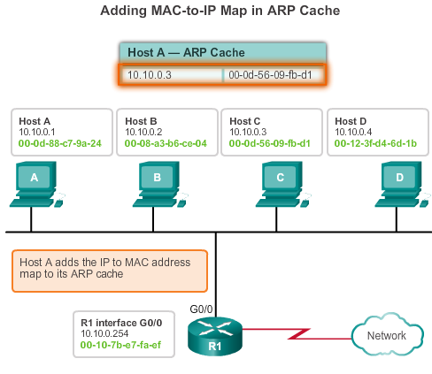
ARP Operation (cont.)
Notes:
10.2.1.3 ARP Operation (cont.)

Slide 38
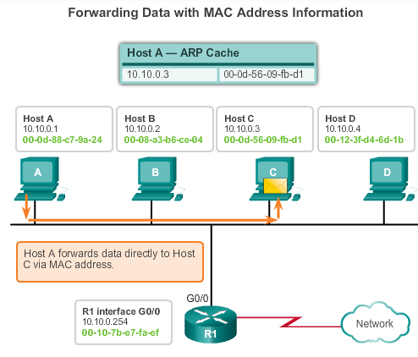
ARP Operation (cont.)
Notes:
10.2.1.3 ARP Operation (cont.)

Slide 39
Addressing: routing to another LAN
walkthrough: send datagram from A to B via R
focus on addressing – at IP (datagram) and MAC layer (frame)
assume A knows B’s IP address
assume A knows IP address of first hop router, R (how?)
assume A knows R’s MAC address (how?)
A
B
R
111.111.111.111
222.222.222.222
74-29-9C-E8-FF-55
49-BD-D2-C7-56-2A
222.222.222.220
1A-23-F9-CD-06-9B
111.111.111.112
111.111.111.110
222.222.222.221
CC-49-DE-D0-AB-7D
E6-E9-00-17-BB-4B
88-B2-2F-54-1A-0F

Slide 40
Addressing: routing to another LAN
A creates IP datagram with IP source A, destination B
A creates link-layer frame with R's MAC address as dest, frame contains A-to-B IP datagram
MAC src: 74-29-9C-E8-FF-55
MAC dest: E6-E9-00-17-BB-4B
IP
Eth
Phy
IP src: 111.111.111.111
IP dest: 222.222.222.222
A
B
R
111.111.111.111
222.222.222.222
74-29-9C-E8-FF-55
49-BD-D2-C7-56-2A
222.222.222.220
1A-23-F9-CD-06-9B
111.111.111.112
111.111.111.110
222.222.222.221
CC-49-DE-D0-AB-7D
E6-E9-00-17-BB-4B
88-B2-2F-54-1A-0F

Slide 41
Addressing: routing to another LAN
frame sent from A to R
frame received at R, datagram removed, passed up to IP
MAC src: 74-29-9C-E8-FF-55
MAC dest: E6-E9-00-17-BB-4B
IP src: 111.111.111.111
IP dest: 222.222.222.222
IP
Eth
Phy
IP src: 111.111.111.111
IP dest: 222.222.222.222
IP
Eth
Phy
A
B
R
111.111.111.111
222.222.222.222
74-29-9C-E8-FF-55
49-BD-D2-C7-56-2A
222.222.222.220
1A-23-F9-CD-06-9B
111.111.111.112
111.111.111.110
222.222.222.221
CC-49-DE-D0-AB-7D
E6-E9-00-17-BB-4B
88-B2-2F-54-1A-0F

Slide 42
Addressing: routing to another LAN
R forwards datagram with IP source A, destination B
R creates link-layer frame with B's MAC address as dest, frame contains A-to-B IP datagram
MAC src: 1A-23-F9-CD-06-9B
MAC dest: 49-BD-D2-C7-56-2A
IP
Eth
Phy
IP
Eth
Phy
IP src: 111.111.111.111
IP dest: 222.222.222.222
A
B
R
111.111.111.111
222.222.222.222
74-29-9C-E8-FF-55
49-BD-D2-C7-56-2A
222.222.222.220
1A-23-F9-CD-06-9B
111.111.111.112
111.111.111.110
222.222.222.221
CC-49-DE-D0-AB-7D
E6-E9-00-17-BB-4B
88-B2-2F-54-1A-0F

Slide 43
Addressing: routing to another LAN
R forwards datagram with IP source A, destination B
R creates link-layer frame with B's MAC address as dest, frame contains A-to-B IP datagram
MAC src: 1A-23-F9-CD-06-9B
MAC dest: 49-BD-D2-C7-56-2A
IP src: 111.111.111.111
IP dest: 222.222.222.222
IP
Eth
Phy
A
B
R
111.111.111.111
222.222.222.222
74-29-9C-E8-FF-55
49-BD-D2-C7-56-2A
222.222.222.220
1A-23-F9-CD-06-9B
111.111.111.112
111.111.111.110
222.222.222.221
CC-49-DE-D0-AB-7D
E6-E9-00-17-BB-4B
88-B2-2F-54-1A-0F

Slide 44
MAC and IP
MAC Address
This address does not change
Similar to the name of a person
Known as physical address because physically assigned to the host NIC
IP Address
Similar to the address of a person
Based on where the host is actually located
Known as a logical address because assigned logically
Assigned to each host by a network administrator
Notes:
10.1.4.1 MAC and IP

Slide 45
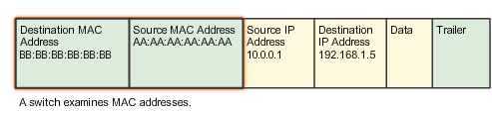
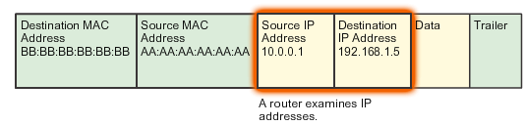
End-to-End Connectivity, MAC, and IP
IP Packet Encapsulated in an Ethernet Frame
Notes:
10.1.4.2 End-to-End Connectivity, MAC, and IP

Slide 46
Link layer, LANs: outline
5.1 introduction, services
5.2 error detection, correction
5.3 multiple access protocols
5.4 LANs
addressing, ARP
Ethernet
switches
VLANS
5.7 a day in the life of a web request

Slide 47
LLC and MAC Sublayers
Ethernet
One of the most widely used LAN technologies
Operates in the data link layer and the physical layer
Family of networking technologies defined in the IEEE 802.2 and 802.3 standards
Supports data bandwidths of 10, 100, 1000, 10,000, 40,000, and 100,000 Mb/s (100 Gb/s)
Ethernet Standards
Define Layer 2 protocols and Layer 1 technologies
Two separate sub layers of the data link layer to operate – Logical Link Control (LLC) and the MAC sublayers
Notes:
10.1.1.1 LLC and MAC Sublayers

Slide 48
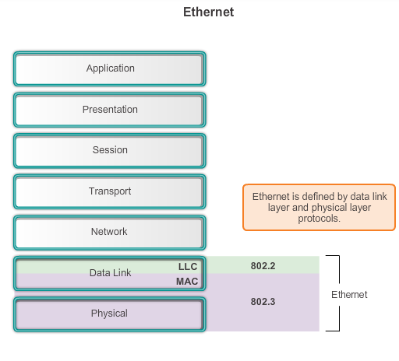
LLC and MAC Sublayers (cont.)
Notes:
10.1.1.1 LLC and MAC Sublayers (cont.)

Slide 49
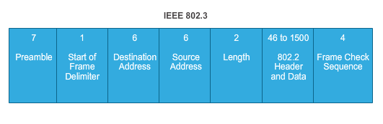
Ethernet Frame
Preamble and Start Frame Delimiter Fields –
Used for synchronization between the sending and receiving devices.
Length/Type Field –
Defines the exact length of the frame’s data field; describes which protocol is implemented.
Data and Pad Fields –
Contains the encapsulated data from a higher layer; an IPv4 packet.
Notes:
10.1.2.3 Introduction to the Ethernet Frame

Slide 50
802.3 Ethernet standards: link & physical layers
many different Ethernet standards
they have common MAC protocol and frame format
different speeds: 2 Mbps, 10 Mbps, 100 Mbps, 1Gbps, 10G bps
different physical layer media: fiber, cable
application
transport
network
link
physical
MAC protocol
and frame format
100BASE-TX
100BASE-T2
100BASE-FX
100BASE-T4
100BASE-SX
100BASE-BX
copper (twister
pair) physical layer
fiber physical layer
Notes:
The leading number (10 in 10BASE-T) refers to the transmission speed in Mbit/s.
BASE denotes that BASEBAND the T designates twisted pair cable
100BASE-SX is a version of Fast Ethernet over optical fiber. It uses two strands of multi-mode optical fiber for receive and transmit.
100BASE-BX is a version of Fast Ethernet over a single strand of optical fiber (unlike 100BASE-FX, which uses a pair of fibers).
broadband refers to the wide bandwidth characteristics of a transmission medium and its ability to transport multiple signals and traffic types simultaneously.
baseband describes a communication system in which information is transported across a single channel

Slide 51
The first part refers to the speed of the standard: 10, 100, 1000, or 10G, for 10 Mbps, 100 Mb, Gb, and 10 Gb Ethernet, respectively.
“BASE” refers to baseband Ethernet, meaning that the physical media only carries Ethernet traffic;
Almost all of the 802.3 standards are for baseband Ethernet.
The final part of the acronym refers to the physical media itself;
Ethernet is both a link-layer and a physical-layer specification.
It is carried over a variety of physical media including coaxial cable, copper wire, and fiber.
Generally, a “T” refers to twisted-pair copper wires.

Slide 52
Link layer, LANs: outline
5.1 introduction, services
5.2 error detection, correction
5.3 multiple access protocols
5.4 LANs
addressing, ARP
Ethernet
switches
VLANS
5.7 a day in the life of a web request

Slide 53
Ethernet switch
It’s a link-layer device: takes an active role
store, forward Ethernet frames
Performs switching and filtering based only on the MAC address
Builds a MAC address table that it uses to make forwarding decisions
Depends on routers to pass data between IP subnetworks
transparent
hosts are unaware of presence of switches
plug-and-play, self-learning
switches do not need to be configured
Table is built automatically, dynamically, and autonomously – without any intervention from a network admin or from a configuration protocol.

Slide 54

Switch: multiple simultaneous transmissions
hosts have dedicated, direct connection to switch
switches buffer packets
Ethernet protocol used on each incoming link, but no collisions;
Switches are full duplex – any switch interface can send and receive at the same time.
each link is its own collision domain
switching: A-to-A’ and B-to-B’ can transmit simultaneously, without collisions
A
C’
B
6
1
2
5
4
3
B’
C
A’
switch with six interfaces
(1,2,3,4,5,6)

Slide 55
Switch forwarding table
Q: how does switch know A’ reachable via interface 4, B’ reachable via interface 5?
A
C’
B
A: each switch has a switch table, each entry:
(MAC address of host, interface to reach host, time stamp)
looks like a routing table!
6
1
2
5
4
3
B’
C
A’
Q: how are entries created,
maintained in switch table?
something like a routing protocol?
switch with six interfaces
(1,2,3,4,5,6)

Slide 56
Switch: self-learning
Source: A
Dest: A’
A switch learns which hosts can be reached through which interfaces
when frame received, switch “learns” location of sender: incoming LAN segment
records sender/location pair in switch table
A
A A’
C’
B
6
1
2
5
4
3
B’
C
A’
MAC addr interface TTL
A
1
60
Switch table
(initially empty)

Slide 57
Switch: frame filtering/forwarding
when frame received at switch:
1. record incoming link, MAC address of sending host
2. index switch table using MAC destination address
3. if entry found for destination then {
if destination on segment from which frame arrived then drop frame
else forward frame on interface indicated by entry
}
else flood /* forward on all interfaces except arriving
interface */

Slide 58
Self-learning, forwarding: example
Source: A
Dest: A’
A
A A’
frame destination, A’, location unknown:
flood
C’
B
destination A location known:
6
1
2
A A’
A A’
A A’
A A’
selectively send
on just one link
A A’
5
4
3
B’
C
A’ A
A’
MAC addr interface TTL
A
1
60
switch table
(initially empty)
A’
4
60

Slide 59

Interconnecting switches
switches can be connected together
S₄
S₁
S₃
A
S₂
F
I
B
C
D
E
G
H
Q: sending from A to G - how does S₁ know to forward frame destined to G via S₄ and S₃?
A: self learning! (works exactly the same as in single-switch case!)

Slide 60
Self-learning multi-switch example
Suppose C sends frame to I, I responds to C
S₄
S₁
S₃
A
S₂
F
I
B
C
D
E
G
H
Q: show switch tables and packet forwarding in S₁, S₂, S₃, S₄

Slide 61
Institutional network
mail server
to external
network
router
web server
IP subnet

Slide 62
Switches vs. routers
application
transport
network
link
physical
both are store-and-forward:
routers: network-layer devices (examine network-layer headers)
switches: link-layer devices (examine link-layer headers)
both have forwarding tables:
routers: compute tables using routing algorithms, IP addresses
switches: learn forwarding table using flooding, learning, MAC addresses
datagram
frame
link
physical
frame
switch
network
link
physical
datagram
frame
application
transport
network
link
physical

Slide 63


Virtual Local Area Networks (VLANs)
The config in fig is hierarchical for modern institution LANs but has some drawbacks:
Lack of traffic isolation. All broadcast traffic must still traverse entire LAN. Limiting scope of such broadcast traffic would improve LAN performance.
It’d also enhance security/ privacy & efficiency
Inefficient use of switches. If instead of 3 groups, the institution had 10 groups, 10 first-level switches would be required. Single switch can’t provide traffic isolation.

Slide 64
VLANs: motivation
Managing users. If CS user moves office to SE, but wants to connect to CS switch, the physical cabling must be changed to connect the user to a different switch.
Fortunately, each of these difficulties can be handled by a switch that supports VLANs
Computer
Science
Computer
Engineering
Software
Engineering

Slide 65
VLANs
port-based VLAN: switch ports grouped (by switch management software) so that single physical switch ……
Virtual Local
Area Network
1
7
9
15
2
8
10
16
switch(es) supporting VLAN capabilities can be configured to define multiple virtual LANS over single physical LAN infrastructure.
…
…
Software Engineering
(VLAN ports 1-8)
Computer Science
(VLAN ports 9-15)
… operates as multiple virtual switches
1
7
9
15
2
8
10
16
…
…
Software Engineering
(VLAN ports 1-8)
Computer Science
(VLAN ports 9-16)

Slide 66

Port-based VLAN
router
traffic isolation: frames to/from ports 1-8 can only reach ports 1-8
can also define VLAN based on MAC addresses of endpoints, rather than switch port
1
7
9
15
2
8
10
16
dynamic membership: ports can be dynamically assigned among VLANs
…
…
Software Engineering
(VLAN ports 1-8)
Computer Science
(VLAN ports 9-15)
forwarding between VLANS: done via routing (just as with separate switches)
in practice vendors sell combined switches plus routers

Slide 67
VLANS spanning multiple switches
1
7
9
15
1
3
5
7
2
8
10
16
2
4
6
8
…
…
Software Engineering
(VLAN ports 1-8)
Computer Science
(VLAN ports 9-15)
Ports 2,3,5 belong to SE VLAN
Ports 4,6,7,8 belong to CS VLAN
trunk port: carries frames between VLANS defined over multiple physical switches
frames forwarded within VLAN between switches can’t be vanilla 802.1 frames (must carry VLAN ID info)
802.1Q protocol adds/removes additional header fields for frames forwarded between trunk ports
Notes:
IEEE 802.1Q standard that supports Virtual LANs (VLANs) on an Ethernet network. defines a system of VLAN tagging for Ethernet frames and the accompanying procedures to be used by bridges and switches in handling such frames.

Slide 68
The 802.1Q frame consists of the standard Ethernet frame with a four-byte VLAN tag added into the header that carries identity of VLAN to which frame belongs.
VLAN tag is added into a frame by the switch at sending side of a VLAN trunk, parsed, and removed by the switch at the receiving side of the trunk.
VLAN tag itself consists of:
A 2-byte Tag Protocol Identifier (TPID) field (with a fixed hexadecimal value of 81-00),
A 2-byte Tag Control Information field that contains a 12-bit VLAN identifier field, and a 3-bit priority field that is similar in intent to the IP datagram TOS (Type of Service) field.

Slide 69
802.1Q VLAN frame format
type
preamble
dest.
address
source
address
data (payload)
CRC
802.1 frame
type
preamble
dest.
address
source
address
data (payload)
CRC
802.1Q frame
2-byte Tag Protocol Identifier
(value: 81-00)
Recomputed
CRC
Tag Control Information (12 bit VLAN ID field,
3 bit priority field like IP TOS)

Slide 70
Link layer, LANs: outline
5.1 introduction, services
5.2 error detection, correction
5.3 multiple access protocols
5.4 LANs
addressing, ARP
Ethernet
switches
VLANS
5.7 a day in the life of a web request

Slide 71
Synthesis: a day in the life of a web request
journey down protocol stack complete!
application, transport, network, link
putting-it-all-together: synthesis!
goal: identify, review, understand protocols (at all layers) involved in seemingly simple scenario: requesting www page
scenario: student attaches laptop to campus network, requests/receives www.google.com

Slide 72
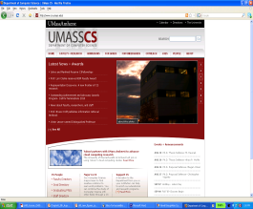


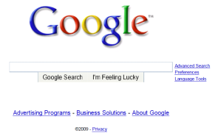
A day in the life: scenario
browser
DNS server
Comcast network
68.80.0.0/13
school network
68.80.2.0/24
web page
web server
Google’s network
64.233.160.0/19
64.233.169.105

Slide 73
A day in the life… connecting to the Internet
DHCP
DHCP
UDP
IP
Eth
Phy
connecting laptop needs to get its own IP address, addr of first-hop router, addr of DNS server: use DHCP
DHCP
DHCP
DHCP
DHCP
DHCP request encapsulated in UDP, encapsulated in IP, encapsulated in 802.3 Ethernet
DHCP
DHCP
UDP
IP
Eth
Phy
DHCP
DHCP
DHCP
DHCP
router
(runs DHCP)
Ethernet frame broadcast (dest: FFFFFFFFFFFF) on LAN, received at router running DHCP server
Ethernet demuxed to IP demuxed, UDP demuxed to DHCP

Slide 74
A day in the life… connecting to the Internet
DHCP
DHCP
UDP
IP
Eth
Phy
DHCP server formulates DHCP ACK containing client’s IP address, IP address of first-hop router for client, name & IP address of DNS server
DHCP
DHCP
DHCP
encapsulation at DHCP server, frame forwarded (switch learning) through LAN, demultiplexing at client
DHCP
DHCP
UDP
IP
Eth
Phy
DHCP
DHCP
DHCP
router
(runs DHCP)
DHCP
DHCP client receives DHCP ACK reply
Client now has IP address, knows name & addr of DNS
server, IP address of its first-hop router

Slide 75
A day in the life… ARP (before DNS, before HTTP)
DNS
UDP
IP
Eth
Phy
before sending HTTP request, need IP address of www.google.com: DNS
DNS
DNS
DNS
ARP
ARP query
DNS query created, encapsulated in UDP, encapsulated in IP, encapsulated in Eth. To send frame to router, need MAC address of router interface: ARP
ARP
ARP reply
Eth
Phy
router
(runs DHCP)
ARP query broadcast, received by router, which replies with ARP reply giving MAC address of router interface
client now knows MAC address of first hop router, so can now send frame containing DNS query

Slide 76
A day in the life… using DNS
DNS
UDP
IP
Eth
Phy
DNS
DNS server
DNS
UDP
IP
Eth
Phy
DNS
DNS
DNS
DNS
DNS
DNS
DNS
DNS
Comcast network
68.80.0.0/13
IP datagram forwarded from campus network into comcast network, routed (tables created by RIP, OSPF, IS-IS and/or BGP routing protocols) to DNS server
router
(runs DHCP)
IP datagram containing DNS query forwarded via LAN switch from client to 1st hop router
demux’ed to DNS server
DNS server replies to client with IP address of www.google.com

Slide 77
A day in the life…TCP connection carrying HTTP
HTTP
HTTP
TCP
IP
Eth
Phy
SYNACK
SYN
SYNACK
SYN
SYNACK
SYN
SYN
to send HTTP request, client first opens TCP socket to web server
router
(runs DHCP)
TCP SYN segment (step 1 in 3-way handshake) inter-domain routed to web server
TCP
IP
Eth
Phy
SYNACK
SYN
SYNACK
SYN
SYNACK
SYNACK
SYN
web server responds with TCP SYNACK (step 2 in 3-way handshake)
web server
64.233.169.105
TCP connection established!

Slide 78
A day in the life… HTTP request/reply
HTTP
HTTP
TCP
IP
Eth
Phy
web page finally (!!!) displayed
HTTP
HTTP
HTTP
HTTP
HTTP
HTTP
HTTP
HTTP
HTTP request sent into TCP socket
router
(runs DHCP)
IP datagram containing HTTP request routed to www.google.com
HTTP
HTTP
TCP
IP
Eth
Phy
HTTP
HTTP
HTTP
web server responds with HTTP reply (containing web page)
HTTP
web server
64.233.169.105
IP datagram containing HTTP reply routed back to client

Slide 79
Chapter 5: Summary
principles behind data link layer services:
error detection, correction
sharing a broadcast channel: multiple access
link layer addressing
instantiation and implementation of various link layer technologies
Ethernet
switched LANS, VLANs
virtualized networks as a link layer: MPLS
synthesis: a day in the life of a web request

Slide 80
Chapter 5: let’s take a breath
journey down protocol stack complete (except PHY)
solid understanding of networking principles, practice
….. could stop here …. but lots of interesting topics!
wireless
multimedia
security
network management

